Slide 1
Introduction to R

Slide 2
Goals for Today
Downloading R and R Studio
Installing packages
Getting Started with Swirl
R Programming
Regression Models
2
Notes:
2

Slide 3
Downloading R and R Studio

Slide 4
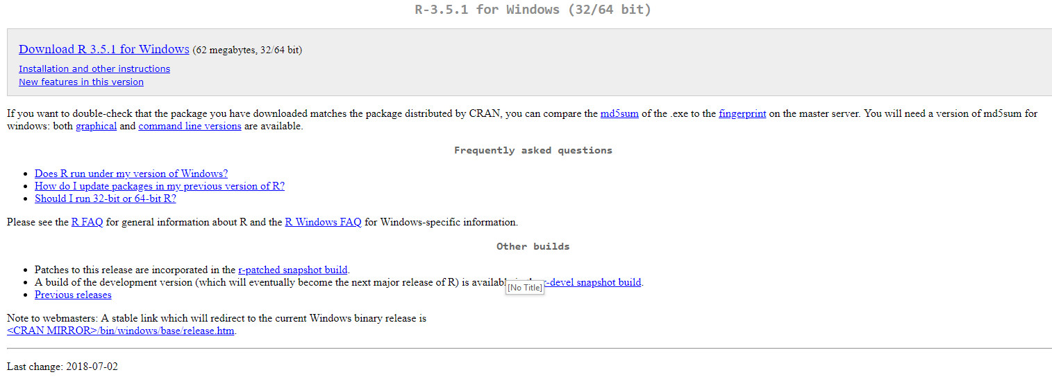
Downloading and Installing R
Navigate to https://www.r-project.org/ and click on “CRAN” underneath the “Download” section of the sidebar. Select the mirror of your choice (the closest is probably https://ftp.ussg.iu.edu/CRAN/) and download the appropriate version of R for your Operating System. If asked, download the “base” subdirectory.
You should be able to accept all the default values in the installer.
4
Notes:
4

Slide 5
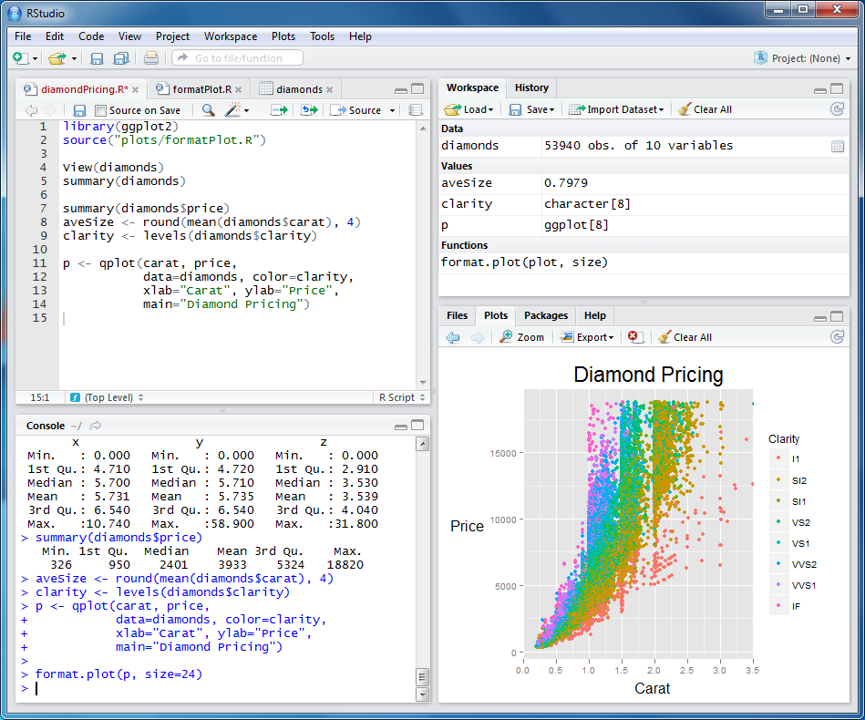
Introduction to R Studio
R Studio is a FREE integrated development environment (IDE) for R and the preferred IDE at Booth. It provides a convenient interface to write code, see your working directory, and examine any plots all at the same time. Here’s an example of what it looks like:
5
Notes:
5

Slide 6
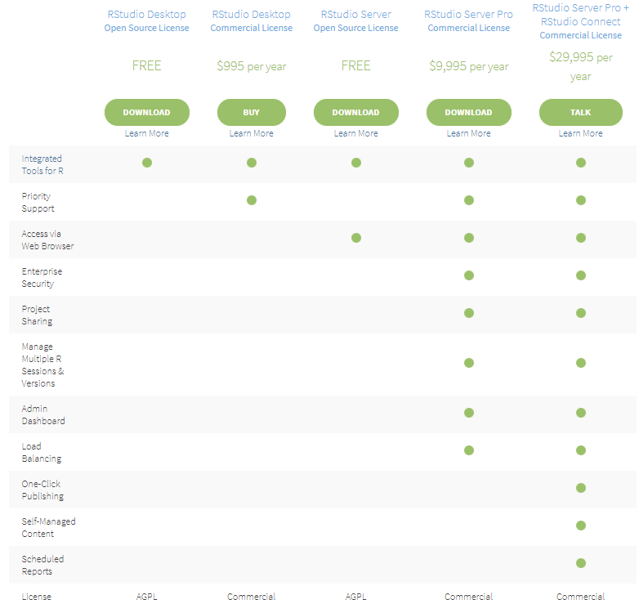
Downloading and Installing R Studio
Navigate to https://www.rstudio.com/products/rstudio/download/ and download “R Studio Desktop” for your operating system. Again, you can use the default installation options.
6
Notes:
6

Slide 7

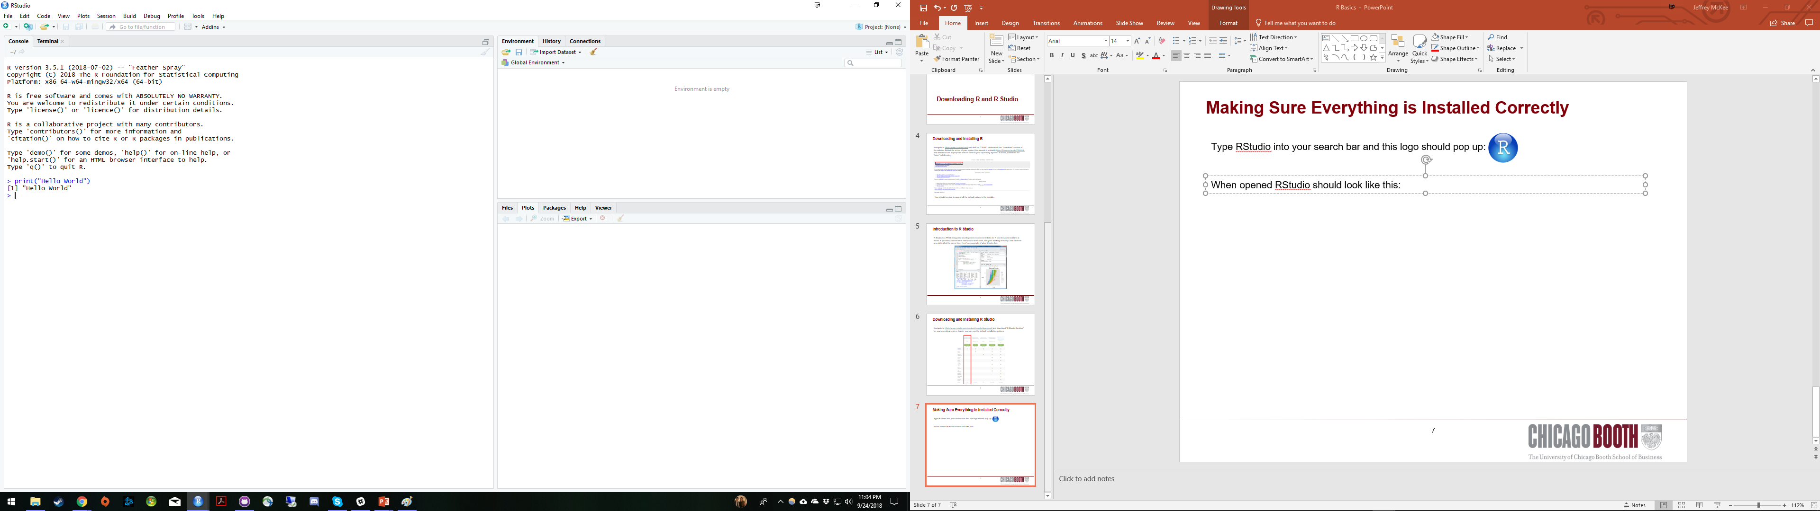
Making Sure Everything is Installed Correctly
Type RStudio into your search bar and this logo should pop up:
Open R studio and try typing in print(“Hello World!”) to make sure everything is working as intended:
Feel free to also trying asking R to perform some basic calculations!
7
Notes:
7

Slide 8
Installing Packages

Slide 9
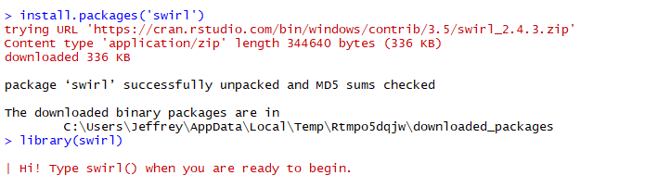
Installing and Loading Packages in R
One of the key strengths of R is the fact that so many R developers have written packages and shared them with the larger community through CRAN (the Comprehensive R Archive Network). Base R allows you to install and load these packages directly through the R interface with the install.packages() and library() functions. The package that we are going to install and use today is “swirl”, a software package for learning R, directly in R!
Type ‘install.packages(“swirl”)’ followed by ‘library(swirl)’. Note that quotation marks are necessary for the install.packages function but not for library.
This is exactly the same process you will use to install and load any R packages that you may need in the future
9
Notes:
9

Slide 10
Getting Started with Swirl

Slide 11
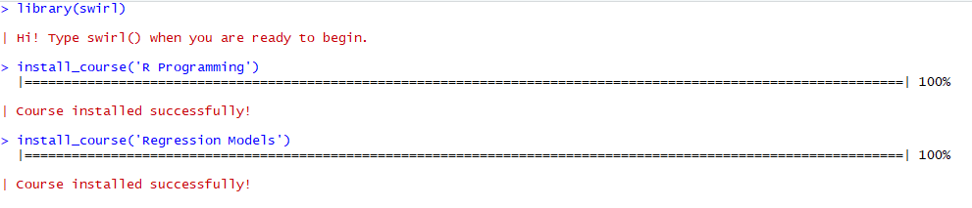
Swirl Courses to Install
Swirl courses can be installed with the following function (which we downloaded when installing the swirl package): install_course().
Let’s install the “R Programming” and “Regression Models” courses
11
Notes:
11

Slide 12
Swirl Lessons to Try
After using the swirl() function to open swirl, it will list the courses you have installed. After selecting a course, it will then list lessons for you to select. For purposes of getting started with R, I recommend you attempt the following courses:
R Programming:
1. Basic Building Blocks
3. Sequences of Numbers
4. Vectors
6. Subsetting Vectors
7. Matrices and Data Frames
Regression Models:
Introduction
Residuals
Least Square Estimation
12
Notes:
12

Slide 13
R Programming

Slide 14
Basic Building Blocks
14
Notes:
14

Slide 15
Regression Models

Slide 16
More Resources
https://swirlstats.com/
https://www.datacamp.com/
http://tryr.codeschool.com/
Or just ask! jmckee0@chicagobooth.edu or @jmckee on Slack
16
Notes:
16

